Slide 1
Homebrewing in 3 minutes
Ollo Swan
ollobeijing@gmail.com
DimSumLab OpenNight Talk
2016.02.02

Slide 2
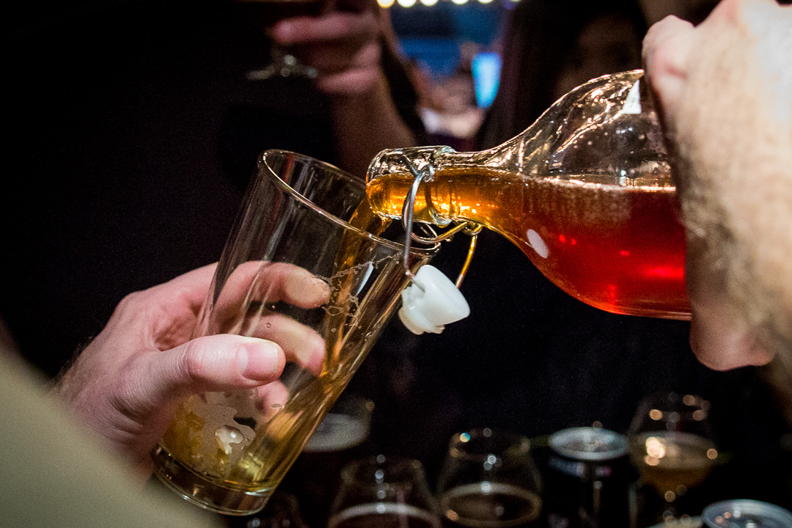
What is beer?

Slide 3
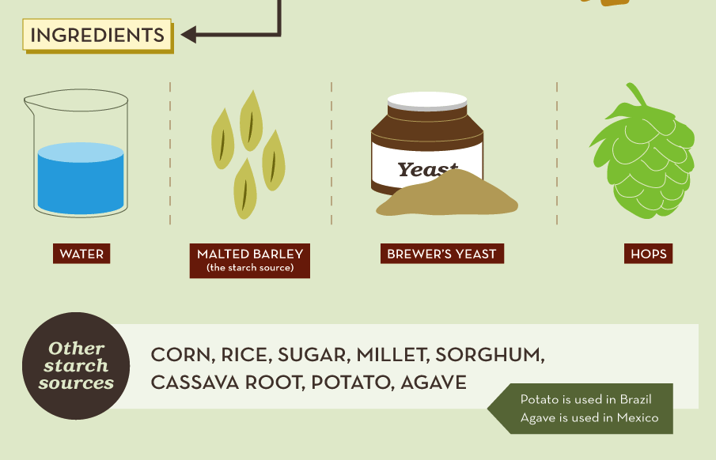
How to make beer

Slide 4
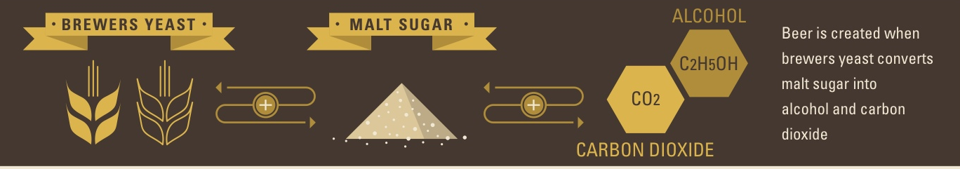
Fermentation

Slide 5
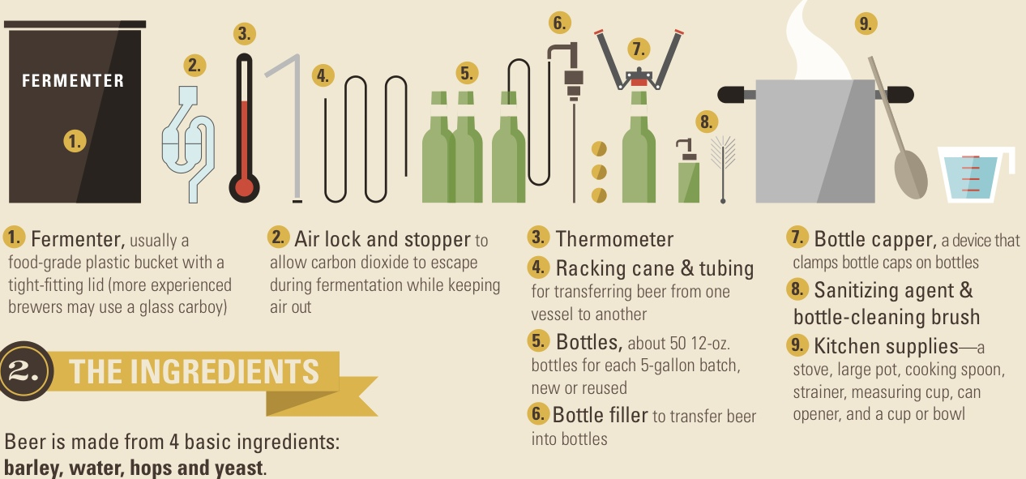
HARDWARE

Slide 6
Time needed
1 day brewing
> 10 days brewing
0.5 day bottling and cleaning
> 10 days conditioning
as many days as you can wait

Slide 7
Hardware on a budget
20 liters pot (or bigger)
thermometer > 100 C
grain bag (best > pot)
Big spoon
water cooler carboy (like in water tank)
silicon food safe hose 2 meters
Cleaning products (brewers wash, dish washer cleaning as a solution)
sanitizing products (iodine, starsan)
bottle filler

Slide 8

http://www.hkbrewcraft.com/

